Slide 1


Aye Nyein Mon
Duygu Ozsoy
Kimberly Bonilla
Mary Mackin
Nicole Kyine Lain
Notes:
Opening speech by Nicole -

Slide 2

Outline
Project Roadwise
Analysis Approach
Data Story
Findings
Future of Roadwise
Q&A
Notes:
Nicole-

Slide 3
Project Roadwise
Developing a Predictive Model for Traffic Accidents in California Using Historical Data from 2021 to 2023
Do accidents occur more frequently on weekdays or weekends?
What are the common causes of traffic accidents?
How do weather conditions influence the likelihood of traffic accidents?
Where do the majority of traffic accidents take place: on highways, interstates, or city streets?
Notes:
Nicole

Slide 4


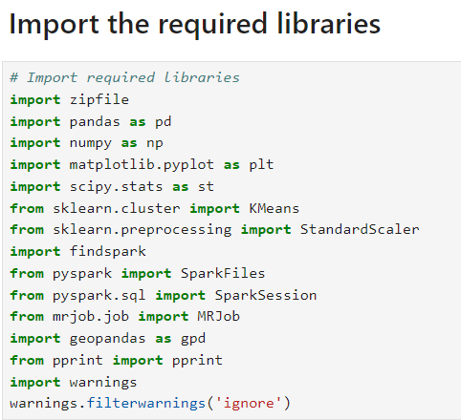


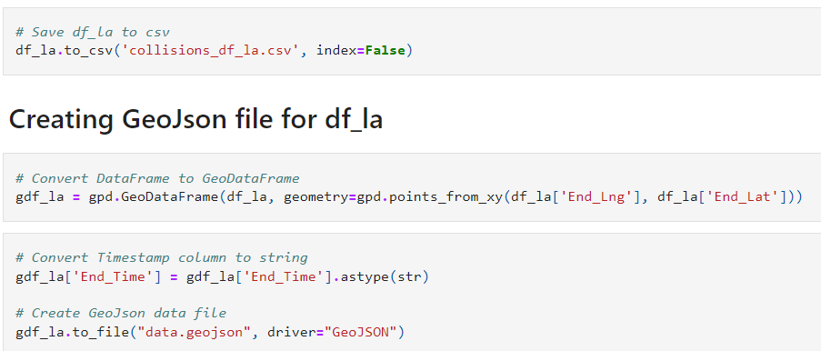

Analysis Approach
Data Collection
Zip file/csv
Data Cleaning
Python/pandas
Jupyter Notebook/google colab
Data Storage
Spark
Machine Learning Library
Scikit-Learn
Data Visualization
Folium | GeoPandas | Matplotlib
GeoJSON | JavaScript | NumPy
Leaflet | Pandas | Plotly
SciPy | Seaborn | Shapely.geometry

Slide 5



Analysis Approach
Data Sources
Kaggle.com US accident 2016-2023
National Highway Transportation Safety Administration
Challenges
Very large data sets
Understanding the effects of different conditions affecting accident rates
Notes:
https://www.nhtsa.gov/file-downloads?p=nhtsa/downloads/FARS/

Slide 6
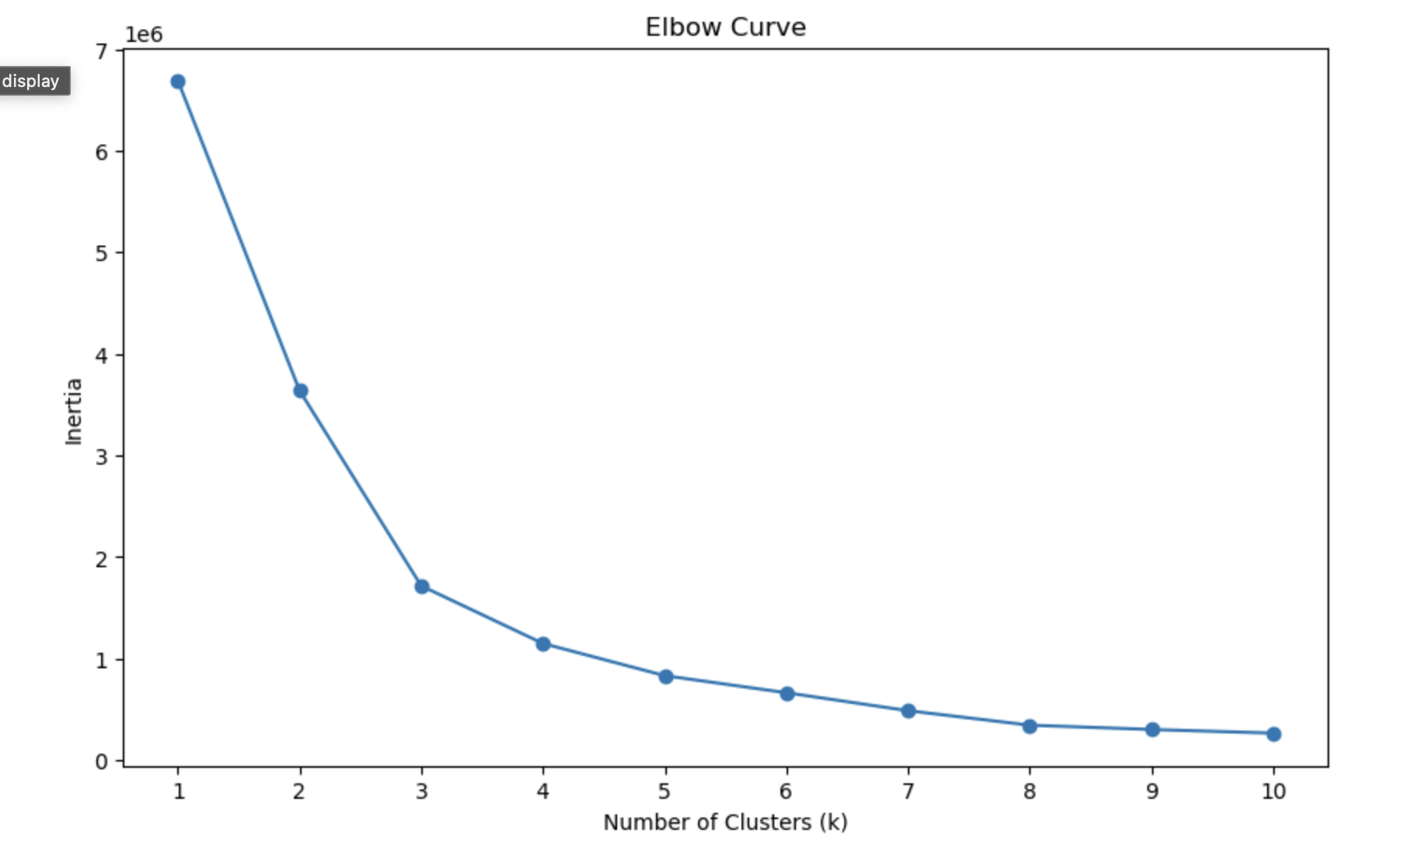
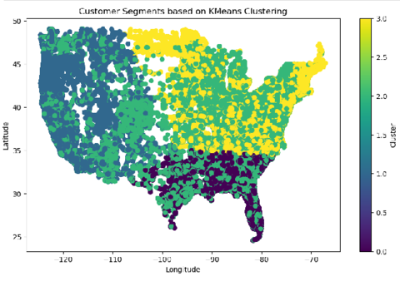
Data Story
K-Means Clustering Analysis
Model Definition
Prediction
Elbow Curve Visualization
Geographical Clustering Plot
Notes:
Kimberly- K-Means Clustering Analysis:
Model Definition:
A K-means model was defined with 3 clusters and fitted to the scaled data.
Prediction:
The model predicted cluster assignments for each data point, and these were added as a new column labeled "Collisions" in the DataFrame.
Elbow Curve Visualization:
An Elbow Curve was plotted to evaluate the inertia for different numbers of clusters (k), helping identify the optimal k where inertia levels off.
Geographical Clustering Plot:
A scatter plot visualized the clusters on a map based on latitude and longitude, with different colors representing different clusters, helping to identify distinct geographical segments.

Slide 7

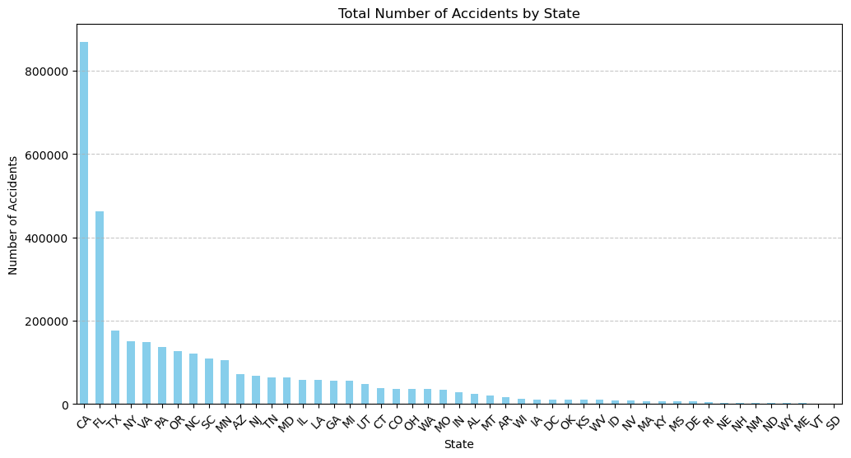


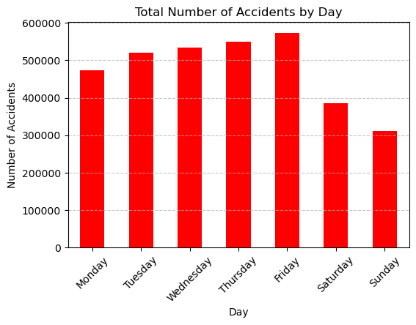
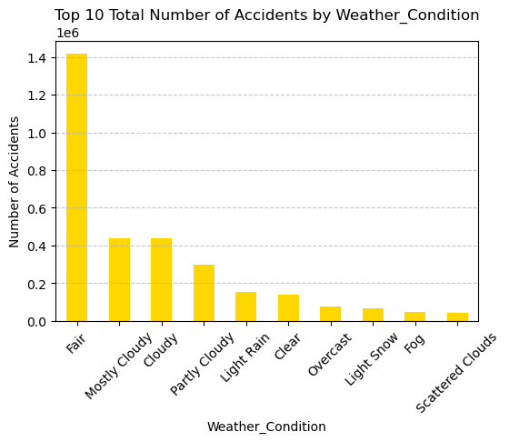

Data Story

Slide 8
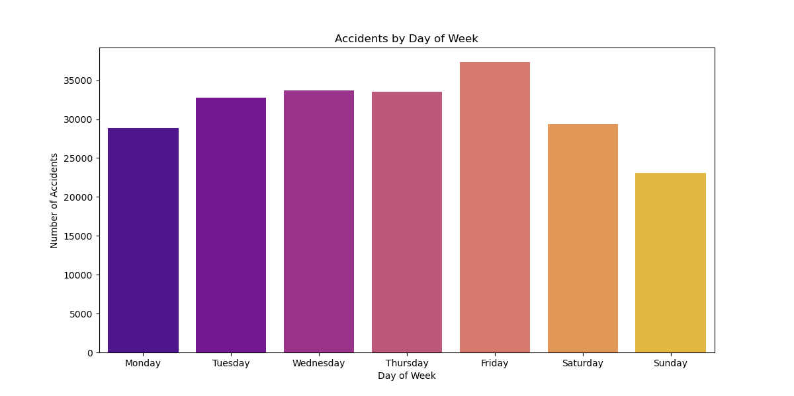
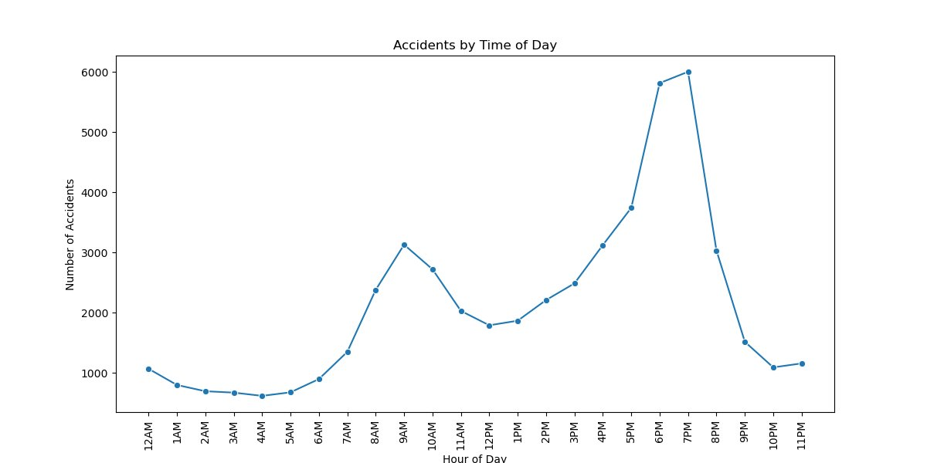
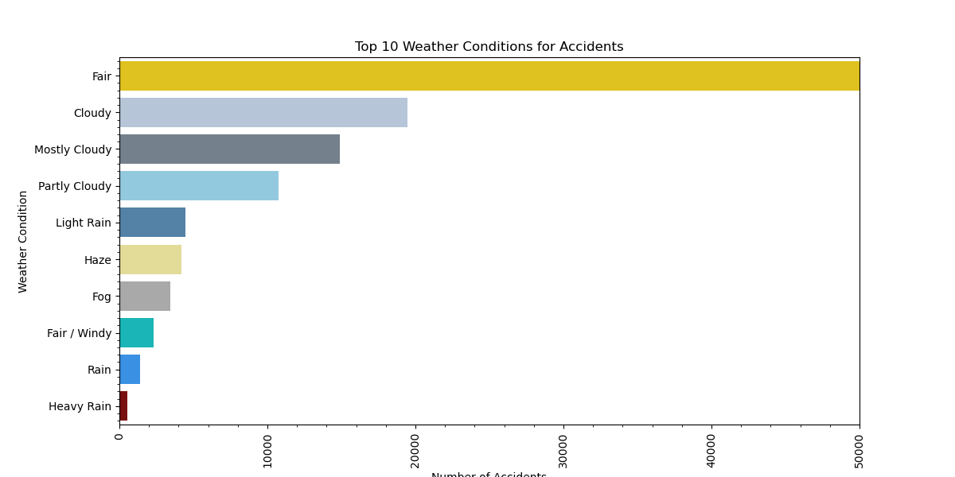
Data Story
Notes:
Mary

Slide 9
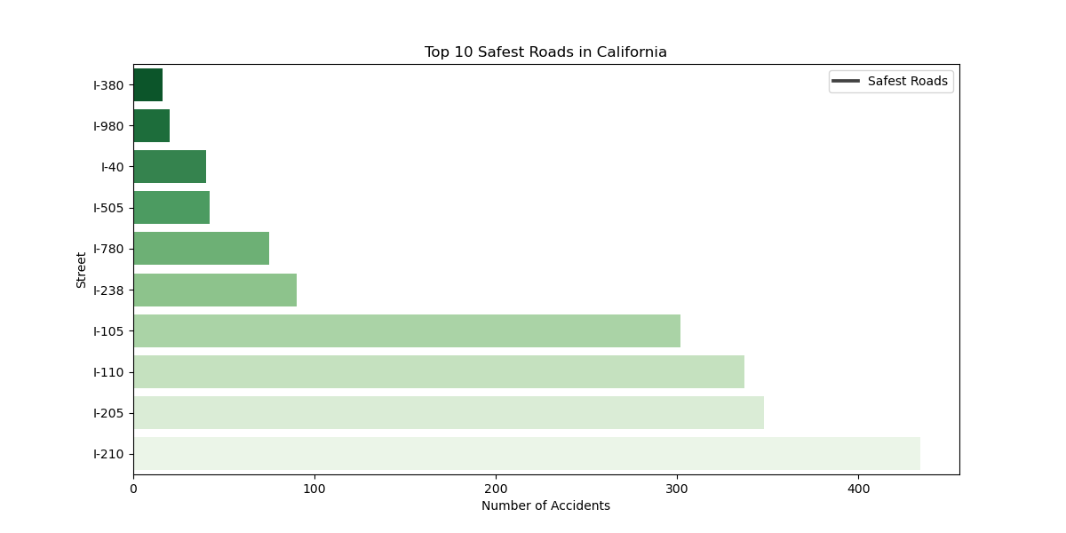
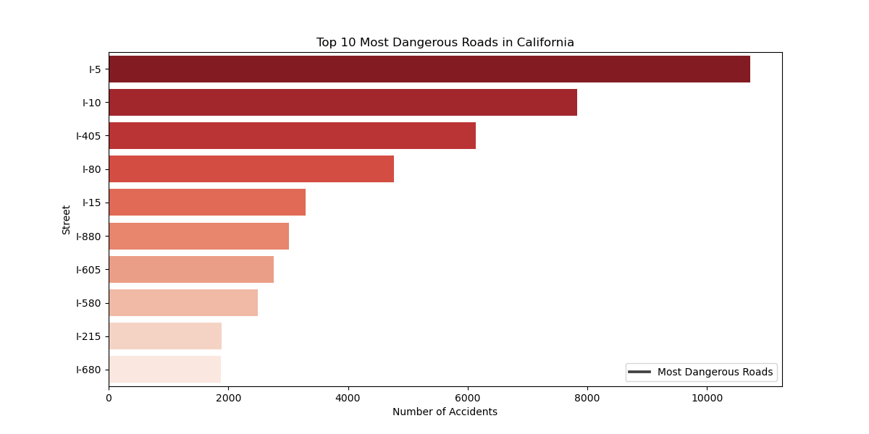
Data Story
Notes:
Mary

Slide 10
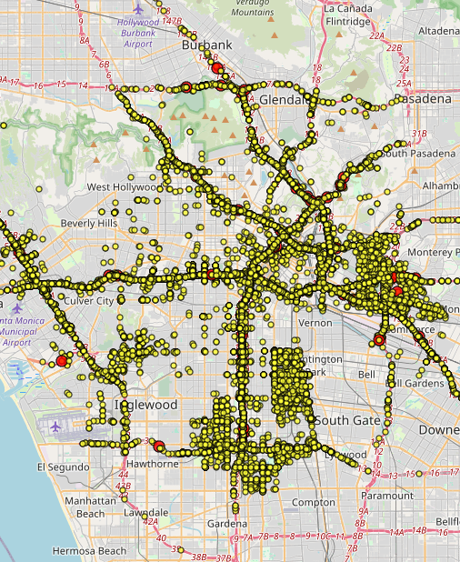
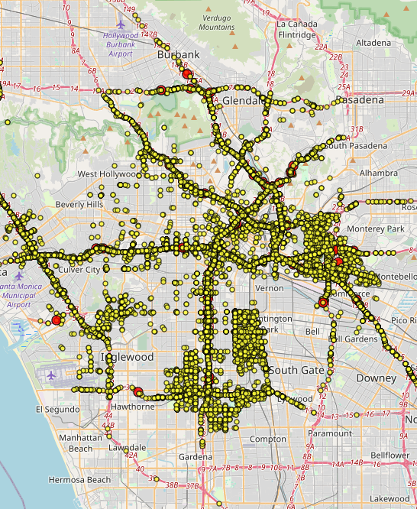
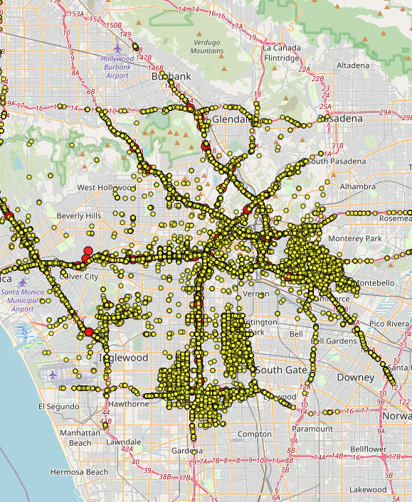
Los Angeles's Traffic Collision Map
Data Story
2020
2021
2022
Map Link: http://127.0.0.1:5500/Traffic_Collisions_Project4/index.html
Notes:
Nicole

Slide 11

Findings
Most accidents happen in clear weather
Major North/South and East/West Highways see the most accidents
Accident numbers spike during AM & PM commute hours
Notes:
Mary- Accidents are more prevalent on weekdays, primarily due to higher traffic volumes during commuting hours.
The most common causes of traffic accidents include distracted driving, speeding, and driving under the influence of alcohol or drugs.
Adverse weather conditions, particularly rain and snow, significantly increase the likelihood of traffic accidents.
The majority of traffic accidents occur on city streets, where the density of intersections, pedestrians, and cyclists is higher

Slide 12

The Future of Roadwise
Expand the data
Create a 'Safest Rout' app
Working with government
Notes:
Mary- Expand the data collection to federal and international sources
Create a 'Safest Rout' app for trip planning which will include consideration of weather conditions and time of day for your trip
Working with government agencies using our data to develop traffic safety improvement recommendations for their most dangerous roads

Slide 13

THANK YOU!
Notes:
Mary

